Slide 1
Meeting 2
Ahad Nardekar
Ahad is an undergraduate student at Indian Institute of Technology Delhi pursuing B.Tech in Civil Engineering. His research focuses on application of AI/ML models to Core Engineering Problems, with prior experience of working on projects such as Structural Analysis Engine, Hydrological Catchment Analysis and Dynamic Analysis of Cracking Patterns in Failures of Structures. As a Research Intern at National University of Singapore, in the Department of Built Environment, he is working on the Forensic Accounting of Corporate Sustainability Pledges using LLMs.

Slide 2
Project
Many APAC firms announce "Net Zero" goals but don't show corresponding capital expenditure in audited financial statements. This creates a gap between what companies say about climate (talk) and what their finances reveal about their actual commitment (walk). TalkScore extracts and scores environmental commitment from ESG reports using NLP, measuring specificity, ambition, scope coverage, and pledge credibility. This TalkScore shall be compared with the real Green Capex of the firms to detect greenwashing and false narratives.

Slide 3
work so far
Built and maintained a structured literature master sheet with full screening and detailed-review columns
Produced a model-family decision sheet comparing six families (lexicon, classical ML, fine-tuned encoders, generative LLMs, RAG, hybrid) on task fit, data needs, strengths, and weaknesses, anchored on one running report example.
Mapped the four reporting regimes (GRI, SASB, TCFD, ISSB/IFRS S2) against Scope 1, 2, and 3 requirements to separate mandatory from self-selected disclosure. [partly Raquel]
Before building, I worked out what to build and how to defend each choice. The result is a documented architecture, two working pipeline stages, and a decision log.

Slide 4
work so far
Refined the proposed model into a 17-step pipeline across five stages: Ingest, Filter and Locate, Extract, Score, Normalise and Output.
Stages A1 and A2 are now implemented in code, covering text extraction (with vision-LLM fallback for image-embedded emission tables), quality checks, paragraph segmentation, structure parsing against the four ISSB pillars, and language detection for bilingual reports.
Each stage borrows specific techniques from the literature rather than being invented, anchored on P1 Bingler et al. 2022 (ClimateBERT for pillar classification), M1 Gorovaia and Makrominas 2025 (lexicon scoring),
The element specificity checklist for Stage D9, that is specificity scoring.

Slide 5
Conclusions from the work so far
Talks Score shall be a normalized muti dimensional vector with categorical and themed dimensions.
The hardest engineering problem in Stage A is not text, it is images. Extracting data from infographics is difficult and needs an LLM only. Moreover, the tabular data is reported in such a way that makes comparison difficult.
RAGs can be used for extracting relevant texts from the long pdfs
No verified greenwashing dataset exists anywhere in the field (P2), so validation leans on proxy tasks and third-party signals and the project cannot claim confirmed greenwashing detection.

Slide 6
Model Architecture
Stage A: Ingest
Text extraction :PDF to raw text (Pdfplumber, Tesseract OCR fallback) 1b. Check and filter out logos and all
Segmentation :split into paragraphs on blank-line boundaries 2b. Structure parser :tag paragraphs with TCFD pillar from report headings 2c. Language detection :flag non-English segments, route to manual review
Stage B: Filter and Locate
3+5. Climate filter and pillar classification :one ClimateBERT pass returns relevance, pillar label, confidence score 4. RAG passage retrieval :pull target-relevant chunks from long reports

Slide 7
Model Architecture
Stage C: Extract
Target detection :identify pledges and extract parameters (baseline year, target year, percentage) 6b. Pledge deduplication :collapse repeated pledges to one canonical instance
Stage D: Score
Lexicon scoring :environmental term density, tone, readability
Modality and tense :tag as past (done), future (promise), or weak modal (soft)
Specificity scoring :element checklist (quantified figure, baseline year, scope coverage, validation, etc.)
Ambition scoring :magnitude of target in sector context
Stage E: Normalise and Output

Slide 8
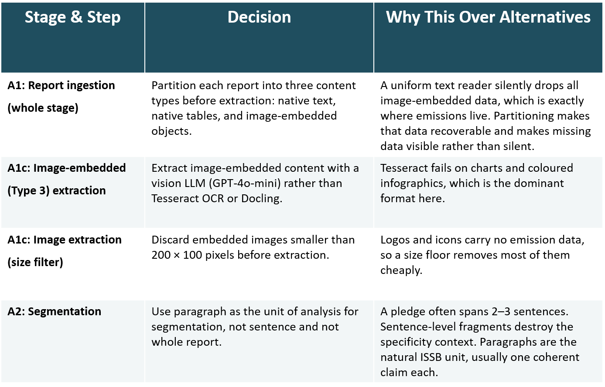
Decision log

Slide 9
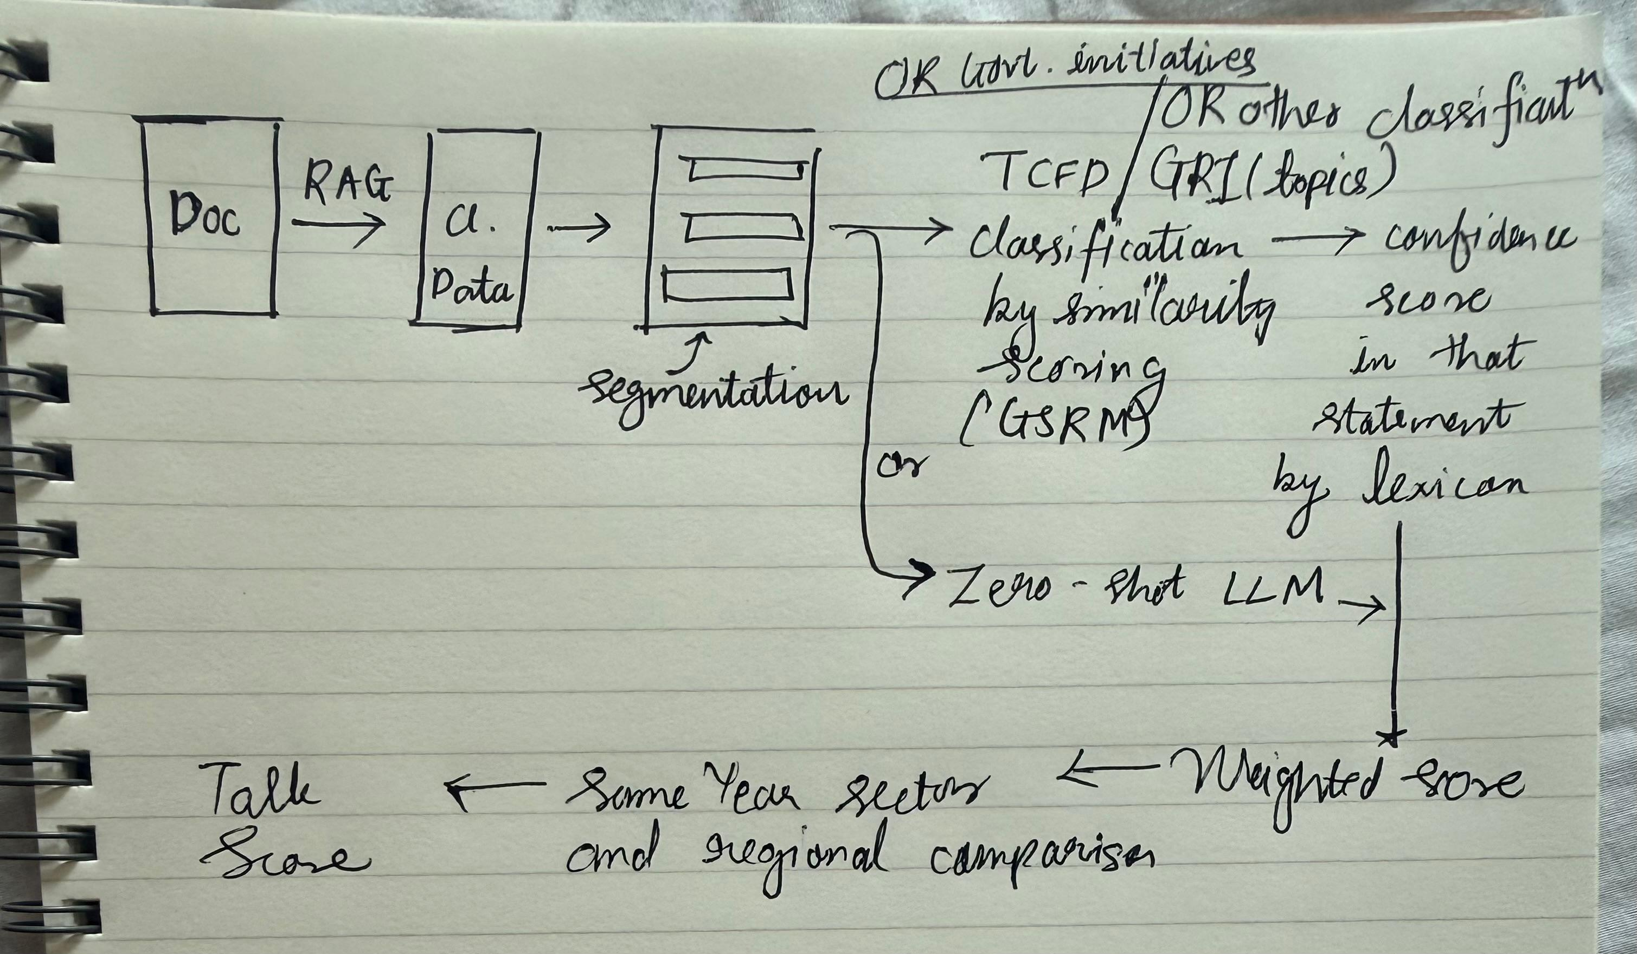
Proposed Model

